Slide 1
The New Alma Viewer
Yoel Kortick – Senior Librarian

Slide 2
  Introduction
  Configuration
  Viewing OCR (Optical Character Recognition) fulltext
  Quick access in Primo
  Share focused file
  Separate Presentation: Customizing the Alma Viewer via Primo Studio

Slide 3


Introduction

Slide 4
Introduction
In March 2020, a new Alma viewer was introduced, with enhanced features over the legacy version.
We will take a look at two of these features here:
  Creating Fulltext
  Share focused file

Slide 5

Configuration

Slide 6
Configuration
To enable the new viewer,
Navigate to: Configuration menu > Fulfillment > Discovery Interface Display Logic > Viewer Services > Alma Viewer
Select “Use New Viewer”

Slide 7
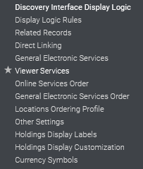
Configuration

Slide 8
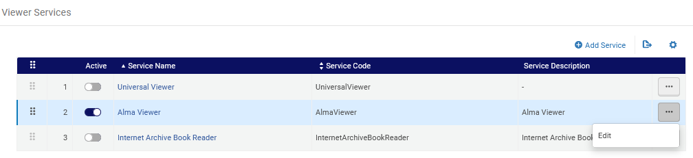
Configuration

Slide 9
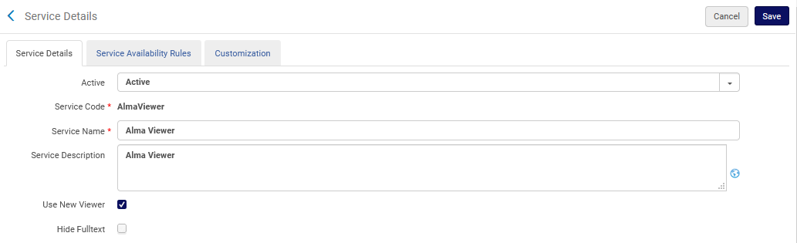
Configuration

Slide 10

Creating Fulltext

Slide 11
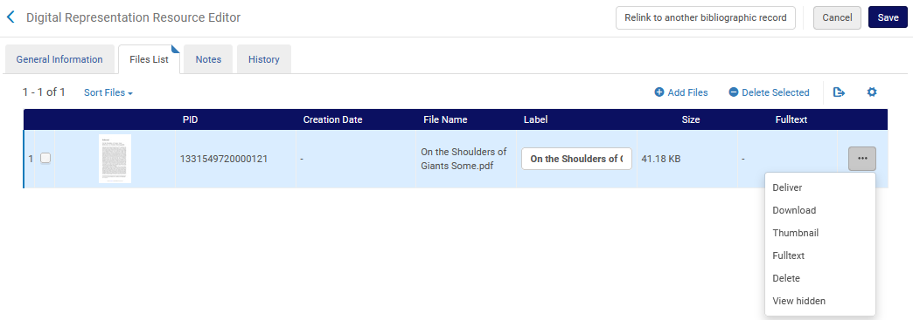
Fulltext
From the files tab of the Digital Representation Resource Editor select “Fulltext”

Slide 12
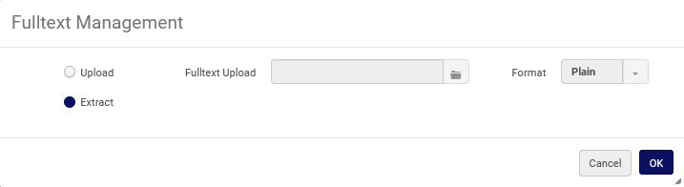
Fulltext
Here we have chosen to extract the full text from the digital file (in this case a pdf)

Slide 13
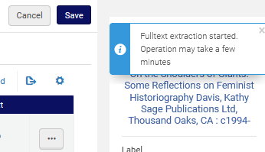
Fulltext
Receive the following message

Slide 14
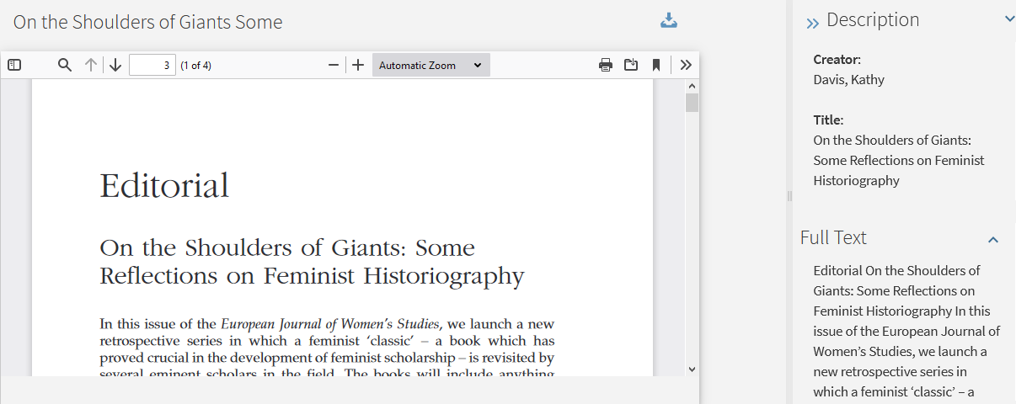
Fulltext
Now the full text appears here in the viewer

Slide 15
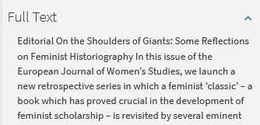
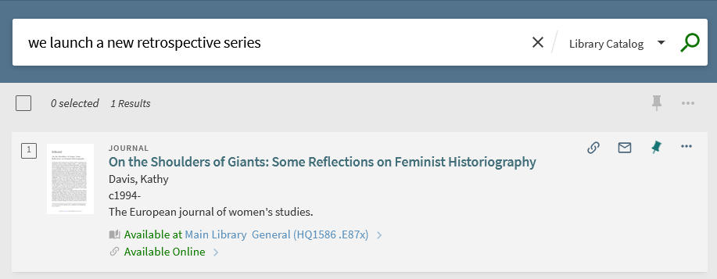
Fulltext
The full text is searchable in Primo VE

Slide 16
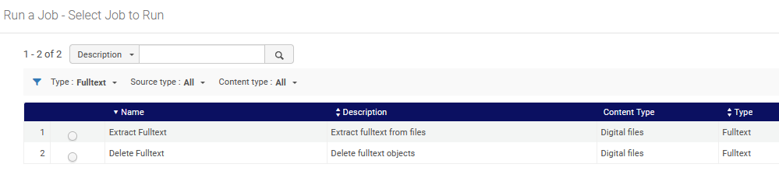
Fulltext
Note that it is also possible to run the “Extract Fulltext” as a batch job instead of “one by one”.

Slide 17

Quick access in Primo

Slide 18
Quick access in Primo
The “Quick Access in Primo” embeds Alma's new digital viewer to allow users to quickly access and view digital representations stored in Alma.
From the embedded viewer, users can
  View files and play audio / video
  Download the file
  Open the representation in a new tab or window
  Select the right/left arrows to view additional representation files.
On the next slide we have an example of “Susan B Anthony” which has one representation and two files. We can see the file in the “Quick Access” and also a link to the Alma Viewer.

Slide 19
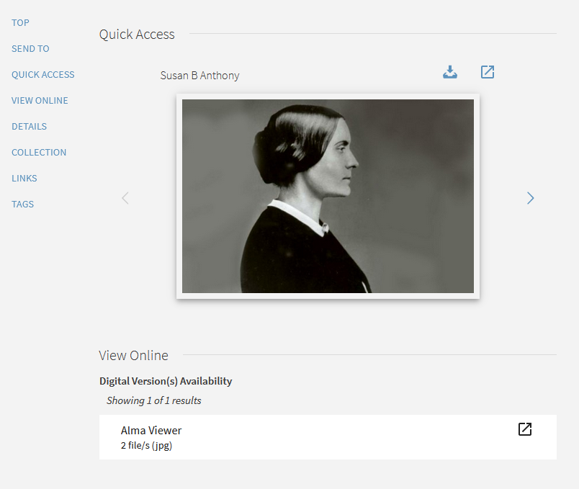
Quick access in Primo
Download file
Open in new window
Move to next file

Slide 20
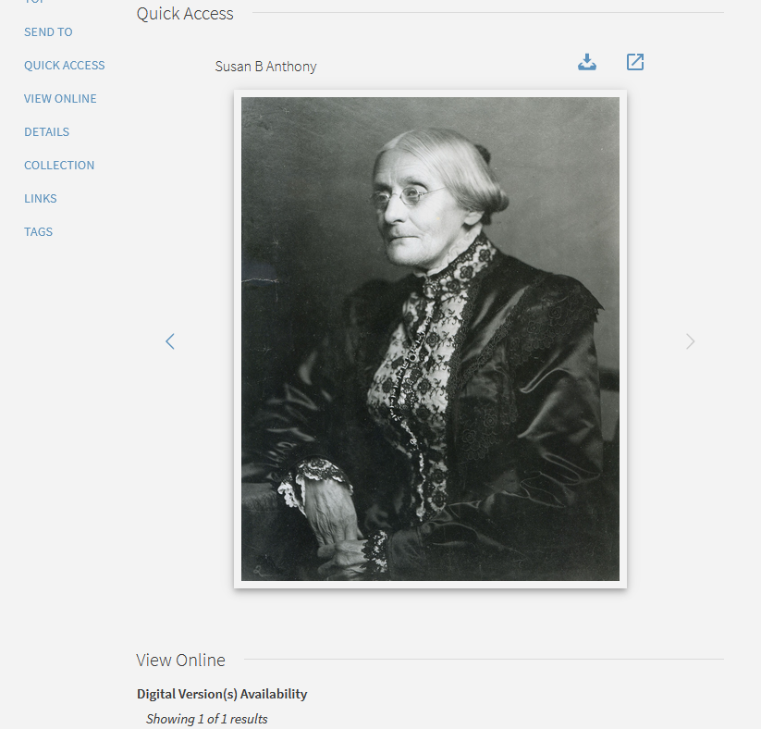
Quick access in Primo
We have moved to the second file and now can scroll back to the first file

Slide 21

Share focused file

Slide 22
Share focused file
The “Share focused file” allows for “File-level Delivery”.
This option appears and is relevant for situations where the representation contains multiple files and the user wants the copied URL to be for the focused file.
When selecting Share Focused File for a file in the new viewer and clicking Copy URL, the link provided opens to the selected file of the representation.
Note that the Share Focused File checkbox appears only when there are multiple files in the representation.

Slide 23
Share focused file
On the next slide we see a representation that has 5 files.
The specific file which is focused is “Gloria Steinem Life Magazine 1977”
If we check “Share focused file” and then “copy URL” the URL will be for the specific file

Slide 24
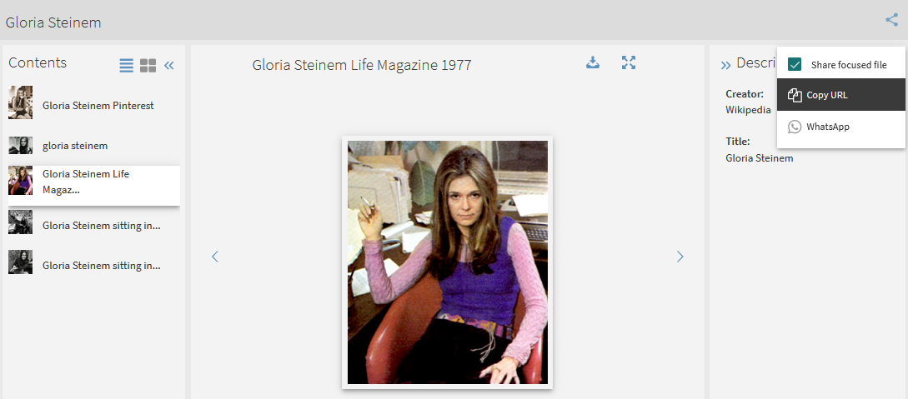
Share focused file
We have checked “Share focused file” and then selected “Copy URL”
There are 5 files

Slide 25
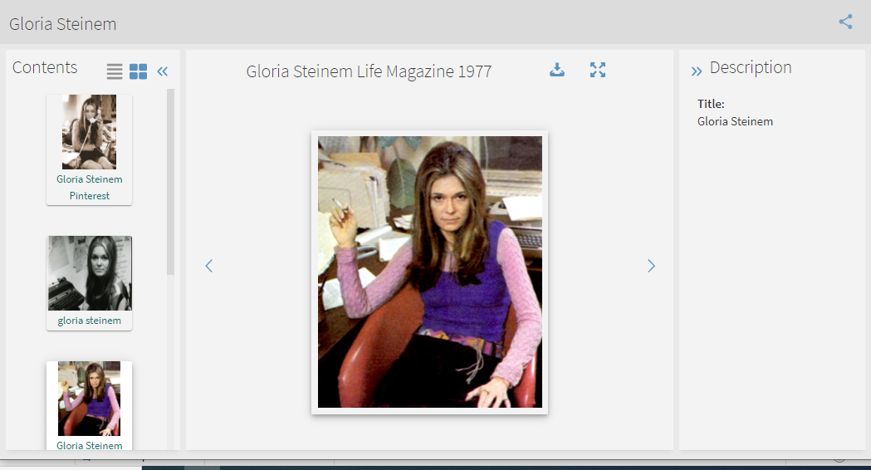
Share focused file
When we paste the copied URL into a browser it shows us the focused file

Slide 26
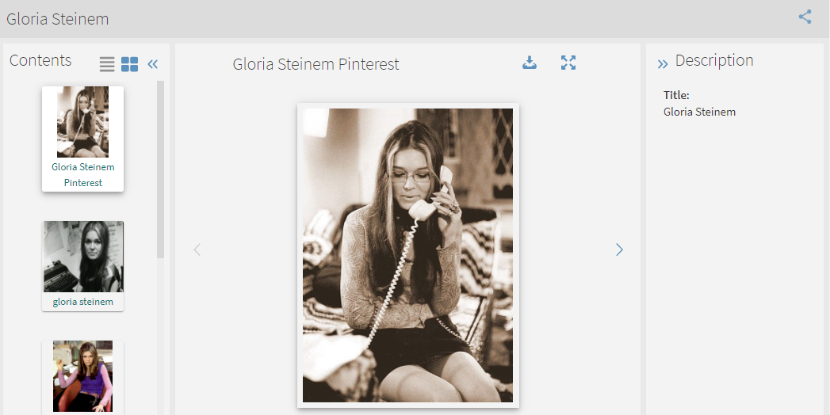
Share focused file
If we had not checked “Share focused file” then the copied URL would have given us the first file

Slide 27
Share focused file
Here is the URL when we checked “share focused file”
https://eu00.alma.exlibrisgroup.com/discovery/delivery/EXLDEV1_INST:Alma/1231549370000121?lang=en#1338080000000121
Here is the URL when we did not check “share focused file”
https://eu00.alma.exlibrisgroup.com/discovery/delivery/EXLDEV1_INST:Alma/1231549370000121?lang=en

Slide 28
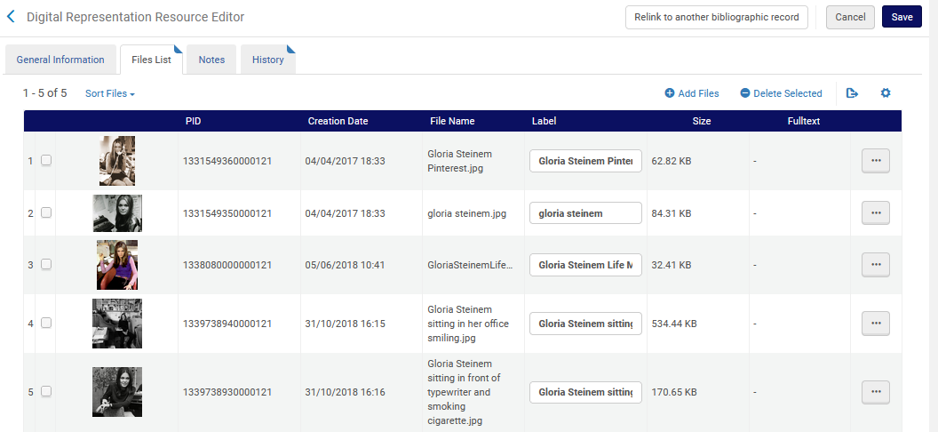
Share focused file
The number which was added to the URL is the PID of the file

Slide 29
xxx@exlibrisgroup.com

